Slide 1
Kings County Real Estate Agency Price Model
By Arsh Patel and Musa Abbasi

Slide 2
Business Problems & Stakeholders
Stakeholder
A real estate agency that is in the Kings County
Business Problem
They want to know what are three important predictors variables of determining house price in Kings County, Washington
What we have
Model predicting house value in Kings County with accuracy of ~81%
Notes:
You want to know what attributes affect house pricing the greatest, and we not only can tell you that, but have a model that can predict house prices within an accuracy of ~80 percent

Slide 3
Data Source
Data on houses sold in Kings County, Washington in 2014
Data on all zipcodes in Kings County, including cities and population
Used data from homes with value under $2 million

Slide 4
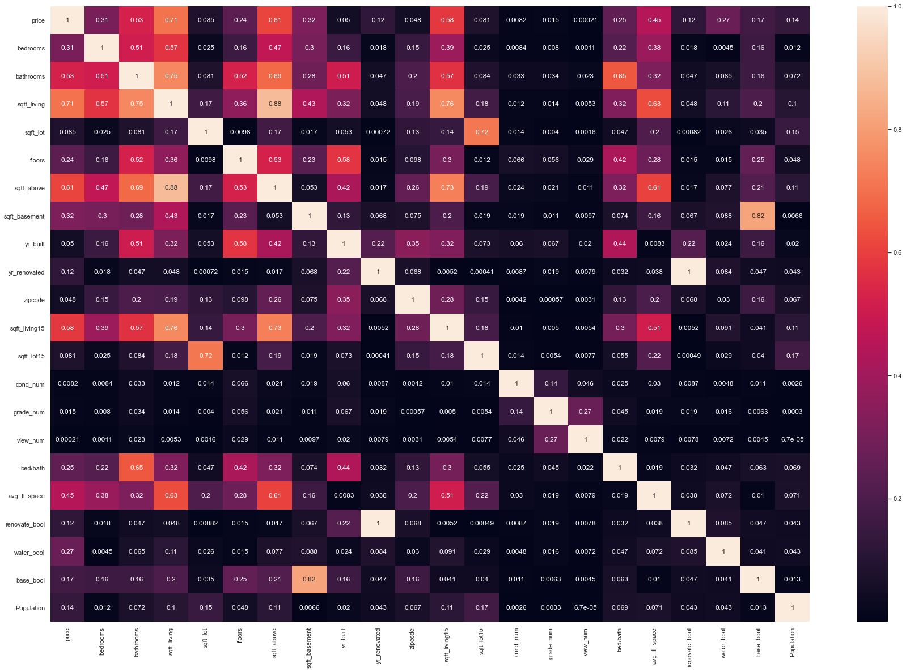
Initial Correlation Heatmap
Variables with highest correlation to Price (coefficient above 0.5)
Square footage of living space in the home
Square footage of house apart from basement
Square footage of living space in the home for the nearest 15 neighbors
Number of bathrooms

Slide 5
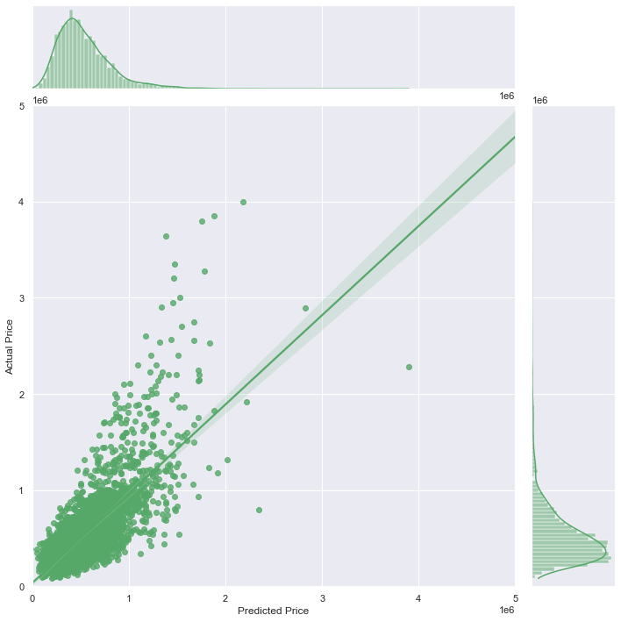
Baseline Model
Accuracy of 63%
R2 for test = 0.6452450846575836
MAE = 137522.88930681013

Slide 6
Improving the model
Initial model accuracy was 63%
Added zipcodes
Removed variables
Created more variables
Accuracy in final model went up to 80%
Notes:
Used data from zipcode information in Kings County
Used as proxy for neighborhood
Vastly improved model performance
Removed some outliers
Removed variables that reduce accuracy
Similar to final model in accuracy, but not very tight
Removed houses over $2 million

Slide 7
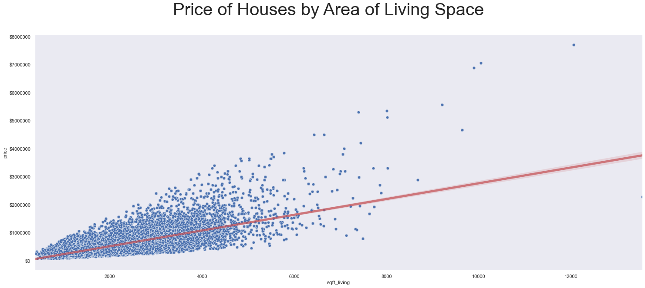
Variables important for modelling

Slide 8
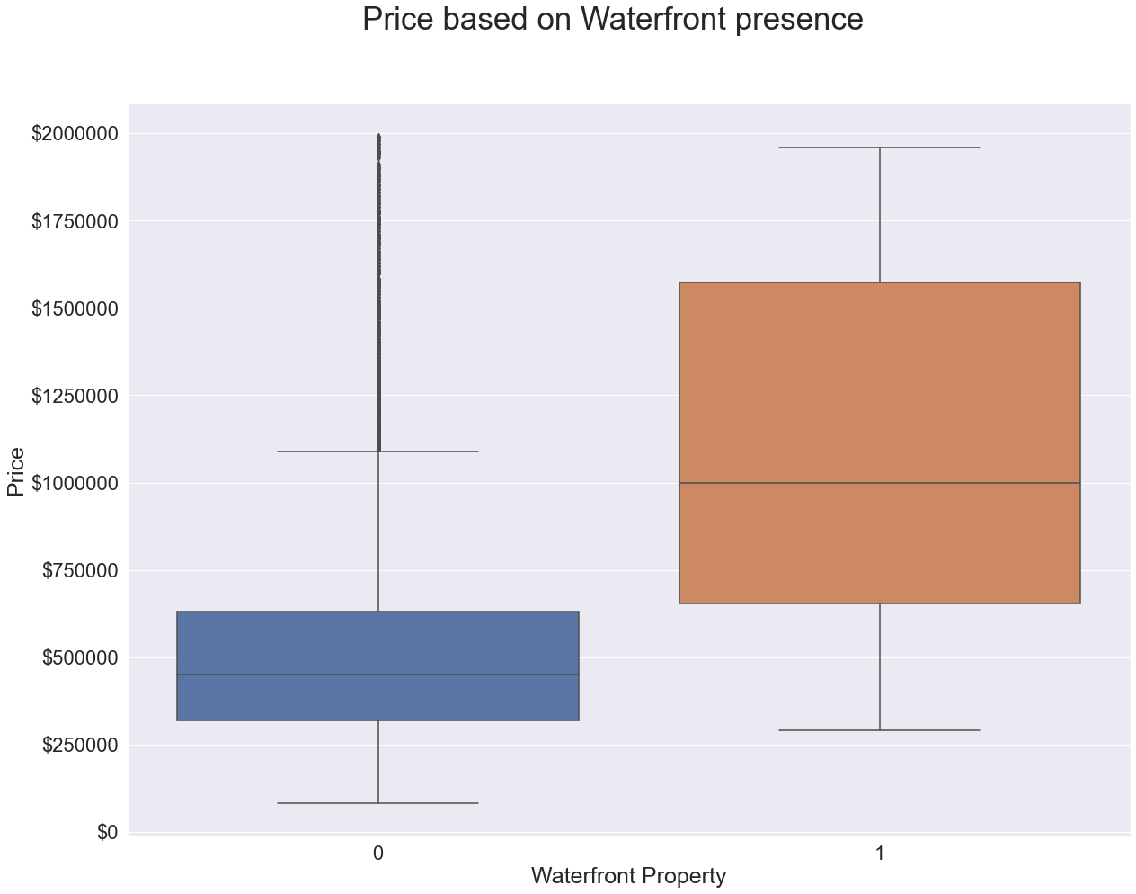
Variables important for modelling

Slide 9
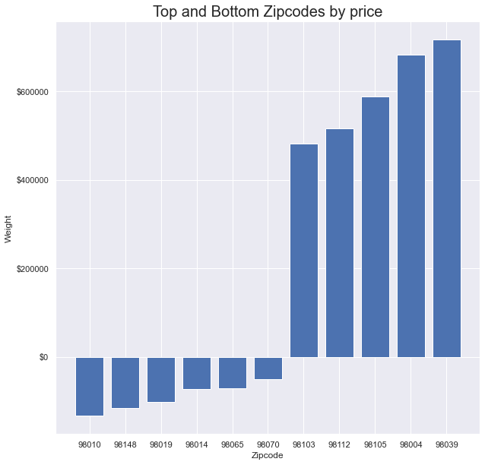
Top 5 zipcodes
Average increase
~$600,000
Bottom 5 zipcodes
Average decrease
~$100,000

Slide 10
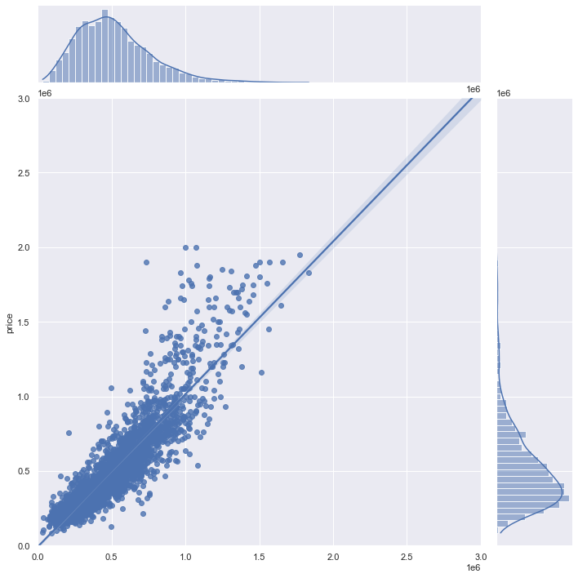
Final Model_2.0
Accuracy of ~80%
R2 for test = 0.8066322136659266
MAE = 87545.85969508639

Slide 11
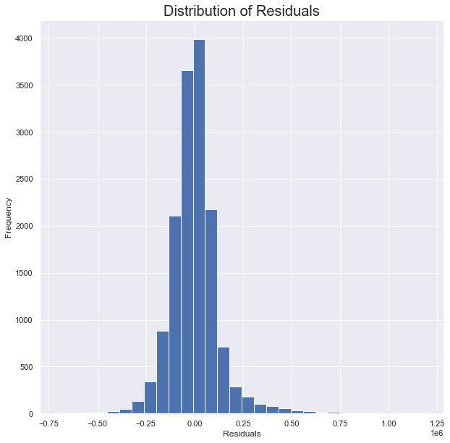

Slide 12
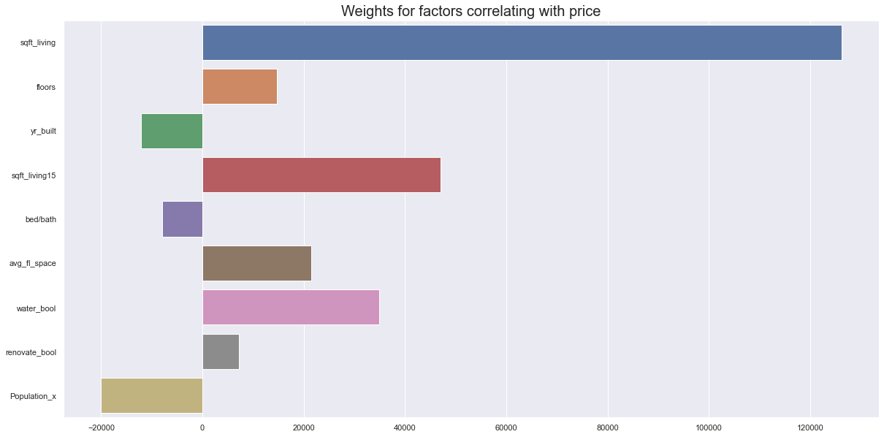

Slide 13
Recommendations
Important attributes in determining house prices
Square footage of house (not necessarily size of property)
Waterfront Property
Zip code

